Slide 1






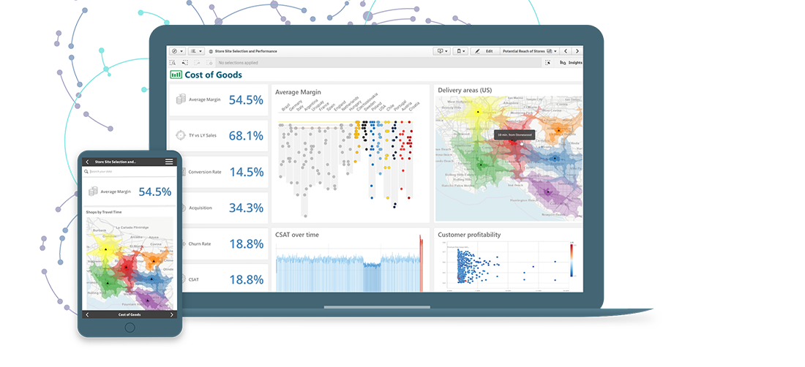
Solution Architecture for Reporting – Order Code
Source
Model
Present
Histological Data
Machine Leaning or Deep Leaning Model
Reporting Platform

